Slide 1



PROJECT PHASE 2
INVESTIGATION ON MICROSTRUCTURE AND MECHANICAL PROPERTIES OF DISSIMILAR LASER AND MIG WELDED AA6061 TO A588K HSLA STEEL
STUDENT BATCH - 10
Moulishankar C 18M629
Gopinath E 19M905
Gowdham MO 19M908
Guided by:
Dr. T. Magesh
Assistant Professor (Sl. Gr.)
Department of Mechanical Engineering
PSG College of Technology
PAGE
Department of Mechanical Engineering
14/03/2023
15M820 | BE SW SEM 10 | 1
17-Nov-20
15M216
BE:

Slide 2
Effect of process variables on residual stresses in dissimilar joint of Al 6082 to HSLA steel
PROJECT PHASE 2
Problem statement
Residual stresses are mostly common in welding components which occurs mainly due to non-uniform heating and cooling of welded joints.
The residual stresses are responsible for most of the failure of weldments in space crafts, marine industries and the temperature distribution is the key measure to predict these residual stresses.
PAGE
Department of Mechanical Engineering
14/03/2023
15M820 | BE SW SEM 10 | 2
17-Nov-20
15M216
BE:

Slide 3
Investigation on microstructure and mechanical properties in dissimilar joint of AA6061 to HSLA steel
PROJECT PHASE 2
Objective
To study the microstructure and mechanical properties of dissimilar laser and MIG welded AA6061 to A588k HSLA steel
To predict the weld bead profile, transient temperature, and residual stresses using numerical method and compare the results.
PAGE
Department of Mechanical Engineering
14/03/2023
15M820 | BE SW SEM 10 | 3
17-Nov-20
15M216
BE:

Slide 4
Investigation on microstructure and mechanical properties in dissimilar joint of AA6061 to HSLA steel
PROJECT PHASE 2
Need of the work / Expected benefits
The motive for efficient joining of Al alloy and steel mainly arises from the need for weight reduction in view of enhancing energy efficiency.
Reducing the adverse impact on environment in automotive, space crafts, locomotive and marine sectors.
PAGE
Department of Mechanical Engineering
14/02/2023
15M820 | BE SW SEM 10 | 4
17-Nov-20
15M216
BE:

Slide 5
Investigation on microstructure and mechanical properties in dissimilar joint of AA6061 to HSLA steel
PROJECT PHASE 2
Literature survey
LASER WELDABILITY OF ALUMINUM ALLOY AND STEEL
Author: Seiji Katayama et al., 2005
One-pass welding of butt and lap joint, or two or three passes welding of lap joints was performed to produce dissimilar welds between steel and aluminium.
It was confirmed that one-pass welding process of butt- and lap-joint was feasible in producing Fe and Al dissimilar welds.
It was found that this unique butt- and lap-one-pass weld joint possessed relatively high strength.
The joint strength increased with an increase in the number of weld bead passes, and a higher strength was achieved at the wider space between weld passes..
PAGE
Department of Mechanical Engineering
14/02/2023
15M820 | BE SW SEM 10 | 5
17-Nov-20
15M216
BE:

Slide 6
Investigation on microstructure and mechanical properties in dissimilar joint of AA6061 to HSLA steel
PROJECT PHASE 2
Literature survey…
INVESTIGATION OF LASER WELDING ON BUTT JOINTS OF ALUMINIUM STEEL DISSIMILAR MATERIAL
Author : Junhao Sun, Qi Yan et al., 2018
Feasible to join aluminum alloy to steel in butt joints using laser welding–brazing method with ER4043 as filler wire.
Better appearance weld can be achieved when a laser power of 3.05 kW, a wire feed speed of 6 m/min and a deviation distance of 0.5 mm were adopted for a plate thickness of 2.5 mm.
All the joints failed at the brazing interface during tensile tests, and the maximum tensile strength of almost 120 MPa can be achieved for butt joints.
PAGE
Department of Mechanical Engineering
14/02/2023
15M820 | BE SW SEM 10 | 6
17-Nov-20
15M216
BE:

Slide 7
Investigation on microstructure and mechanical properties in dissimilar joint of AA6061 to HSLA steel
PROJECT PHASE 2
Literature survey…
EFFECT MICROSTRUCTURES AND PROPERTIES OF WELDED JOINT OF ALUMINUM ALLOY TO GALVANIZED STEEL BY ND : YAG LASER AND MIG ARC HYBRID BRAZING-FUSION WELDING
Author : Guo-liang QIN et al., 2014
6013-T4 aluminium alloy was joined to galvanized steel plate by large spot laser and MIG arc hybrid brazing−fusion welding process with ER4043 filler wire of 1.2 mm diameter.
The tensile strength of joint firstly increases to the maximum and then decreases as the welding current and laser power increase, and the highest tensile strength of the joint can reach up to 247.3 MPa, which is 85% of that of the base metal of 6013-T4 aluminum alloy.
PAGE
Department of Mechanical Engineering
14/02/2023
15M820 | BE SW SEM 10 | 7
17-Nov-20
15M216
BE:

Slide 8
Investigation on microstructure and mechanical properties in dissimilar joint of AA6061 to HSLA steel
PROJECT PHASE 2
Literature survey
DISSIMILAR METAL JOINING OF ALUMINUM TO STEEL BY MIG ARC BRAZING USING FLUX CORED WIRE
Author : Taichi Murakami et al., 2003
The ternary intermetallic compound, Al_{7.4}Fe₂Si was formed at the interface between steel and aluminium weld metal.
The thickness of the intermetallic compound layer at the interface increased with decreasing the welding speed, and increased as the aiming position moved from aluminum to steel side.
PAGE
Department of Mechanical Engineering
14/02/2023
15M820 | BE SW SEM 10 | 8
17-Nov-20
15M216
BE:

Slide 9
Investigation on microstructure and mechanical properties in dissimilar joint of AA6061 to HSLA steel
PROJECT PHASE 2
Literature survey
TWO-PASS LASER WELDING OF GALVANIZED HIGH-STRENGTH DUAL-PHASE STEEL FOR A ZERO-GAP LAP JOINT CONFIGURATION
Author : Junjie Ma et., 2013
Defect-free two-pass laser partially penetrated lap joints were obtained. No spatter or blowholes were produced in the welds. The welding process was very stable. No porosity was observed in the cross-section of the weld.
The micro-hardness profiles of the welded joints show that there was no apparent difference between the lowest micro hardness value of the weld joints obtained by the two-pass laser welding or by the laser welding of galvanized steels without zinc coating along the joint line.
For the tensile shear test, the two-pass welded joints failed in the HAZ zone and the test results indicated that the welds with high-strength have been achieved
PAGE
Department of Mechanical Engineering
14/02/2023
15M820 | BE SW SEM 10 | 9
17-Nov-20
15M216
BE:

Slide 10
Investigation on microstructure and mechanical properties in dissimilar joint of AA6061 to HSLA steel
PROJECT PHASE 2
Literature survey
DISSIMILAR WELDING OF CARBON STEEL TO 5754 ALUMINUM ALLOY BY ND:YAG PULSED LASER
Author : M.J. Torkamany et al., 2009
The penetration depth is increased with the peak power. In laser welding, a good weld is not only a weld with sufficient penetration but also an acceptable weld surface is expected.
These intermetallic compounds have different expansion coefficient relative to aluminum and steel leading to crack propagation during solidification.
The high microhardness value and the brittleness of the phase showing cracks are characteristic of the FexAly intermetallics.
PAGE
Department of Mechanical Engineering
14/02/2023
15M820 | BE SW SEM 10 | 10
17-Nov-20
15M216
BE:

Slide 11
Investigation on microstructure and mechanical properties in dissimilar joint of AA6061 to HSLA steel
PROJECT PHASE 2
Literature survey
STUDY ON LASER WELDING–BRAZING OF ZINC COATED STEEL TO ALUMINUM ALLOY WITH A ZINC BASED FILLER
Author : C. Dharmendra et al., 2010
The study confirms that brazing of zinc coated steels with aluminum alloy is possible using Zn–15Al filler alloy.
High wire speeds of 5-7 times the brazing speeds allowed better filling and spreading of filler alloy. Macro-metallographic analysis shows that filler alloy wets the base metal very well and the wetting angle primary depends on the heat input.
Microhardness measurements indicate that the intermetallic layer has higher hardness than the steel and aluminium sheet.
PAGE
Department of Mechanical Engineering
14/02/2023
15M820 | BE SW SEM 10 | 11
17-Nov-20
15M216
BE:

Slide 12
Investigation on microstructure and mechanical properties in dissimilar joint of AA6061 to HSLA steel
PROJECT PHASE 2
Literature survey
A COMPARISON OF RESIDUAL STRESSES IN MULTI PASS NARROW GAP LASER WELDS AND GAS TUNGSTEN ARC WELDS IN AISI 316L STAINLESS STEEL
Author : A.S. Elmesalamy et al., 2014
The results obtained in this study indicate that NGLW may offer significant advantages for the structural integrity of components in cases where tensile residual stresses and accumulated cold work can accelerate material degradation and crack growth.
The residual stresses were generally 30-40% lower in magnitude for the narrow gap laser welds in comparison to those for GTA welding.
The thickness of the welded samples had a less significant influence on the induced residual stresses than the choice of welding process.
PAGE
Department of Mechanical Engineering
14/02/2023
15M820 | BE SW SEM 10 | 12
17-Nov-20
15M216
BE:

Slide 13
Investigation on microstructure and mechanical properties in dissimilar joint of AA6061 to HSLA steel
PROJECT PHASE 2
Literature survey
INVESTIGATION OF ALUMINUM-STAINLESS STEEL DISSIMILAR WELD QUALITY USING DIFFERENT FILLER METALS
Author : L. H. Shah et al., 2013
The welding voltage had a significant effect on the welding process, as higher voltage resulted in poorer appearance of the weld joint and led to defects for both groups, such as porosity and incomplete fusion.
The microstructure by using aluminium filler shows enrichment of Si particles, which benefited the joint properties by increasing the strength of the metal and the microstructure by using steel filler consists of chromium carbide precipitation which yields a high hardness value, but has a brittle structure.
The tensile strength of Al filler joints ranging from 47.8 to 104.4 MPa were collectively higher than the steel filler joints.
PAGE
Department of Mechanical Engineering
14/02/2023
15M820 | BE SW SEM 10 | 13
17-Nov-20
15M216
BE:

Slide 14
Investigation on microstructure and mechanical properties in dissimilar joint of AA6061 to HSLA steel
PROJECT PHASE 2
Literature survey
CHARACTERIZATION OF INTERMETALLICS IN ALUMINUM TO ZINC COATED INTERSTITIAL FREE STEEL JOINING BY PULSED MIG BRAZING FOR AUTOMOTIVE APPLICATION
Author : Mahadev Shome et al., 2016
Automotive grade 6061 aluminum alloy and zinc coated steel sheet could be successfully joined by MIG brazing using Al–5Si filler wire and joint efficiency as high as 65% of the steel base metal could be achieved.
Large size FeAl3 and small size Fe2Al5 type intermetallic compounds were identified as the main constituents of the interface respectively.
Less thickness of IMC increases the possibilities of fracture at the interface between aluminum alloy and coated steel sheet. In the present study, 182 J/mm having optimum thickness of IMC.
PAGE
Department of Mechanical Engineering
14/02/2023
15M820 | BE SW SEM 10 | 14
17-Nov-20
15M216
BE:

Slide 15
Investigation on microstructure and mechanical properties in dissimilar joint of AA6061 to HSLA steel
PROJECT PHASE 2
Literature survey
DISSIMILAR MIG-CMT WELD-BRAZING OF ALUMINIUM TO STEEL: A REVIEW
Author : A. Jaivindra Singh et al., 2018
Benefits of zinc coating
Reducing heat input to the base material
Increasing the wettability of liquid Al on steel surface
Aluminium with silicon filler requires less amount of heat for melting i.e. the maximum temperature at the interface can be reduced effectively.
The addition of silicon in Al based filler results in the reduction of IM layer thickness and growth of brittle Fe-Al intermetallic compounds which improve the mechanical properties of the weld joint.
PAGE
Department of Mechanical Engineering
14/02/2023
15M820 | BE SW SEM 10 | 15
17-Nov-20
15M216
BE:

Slide 16
Investigation on microstructure and mechanical properties in dissimilar joint of AA6061 to HSLA steel
PROJECT PHASE 2
Literature Summary
Mechanical properties and microstructure characterization of aluminum alloy to steel alloy welded joints using laser and MIG welding.
PAGE
Department of Mechanical Engineering
14/02/2023
15M820 | BE SW SEM 10 | 16
17-Nov-20
15M216
BE:

Slide 17
Investigation on microstructure and mechanical properties in dissimilar joint of AA6061 to HSLA steel
PROJECT PHASE 2
Literature gap
From the available literature review, it is evident that no works have been reported regarding the residual stresses in joining of two dissimilar metals Al 6061 and HSLA steel using laser and MIG welding
PAGE
Department of Mechanical Engineering
14/02/2023
15M820 | BE SW SEM 10 | 17
17-Nov-20
15M216
BE:

Slide 18
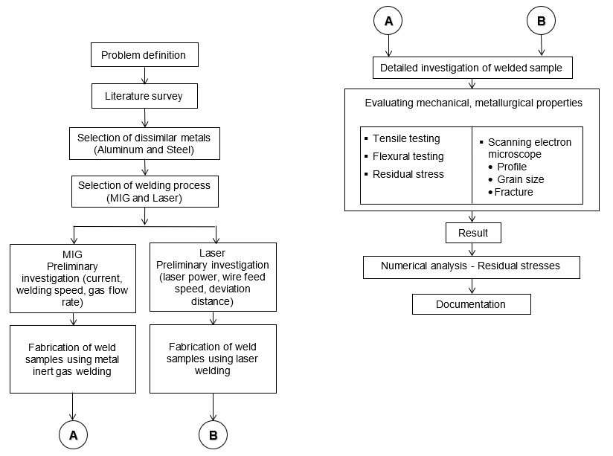
Investigation on microstructure and mechanical properties in dissimilar joint of AA6061 to HSLA steel
PROJECT PHASE 2
Methodology
PAGE
Department of Mechanical Engineering
14/02/2023
15M820 | BE SW SEM 10 | 18
17-Nov-20
15M216
BE:

Slide 19
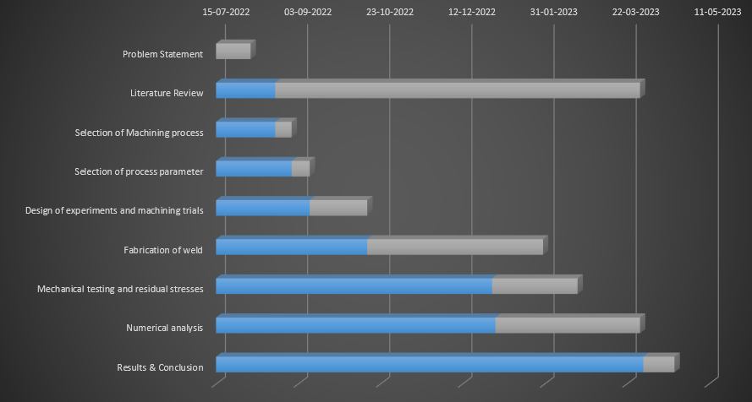
Investigation on microstructure and mechanical properties in dissimilar joint of AA6061 to HSLA steel
PROJECT PHASE 2
Gantt chart
PAGE
Department of Mechanical Engineering
14/02/2023
15M820 | BE SW SEM 10 | 19
17-Nov-20
15M216
BE:

Slide 20
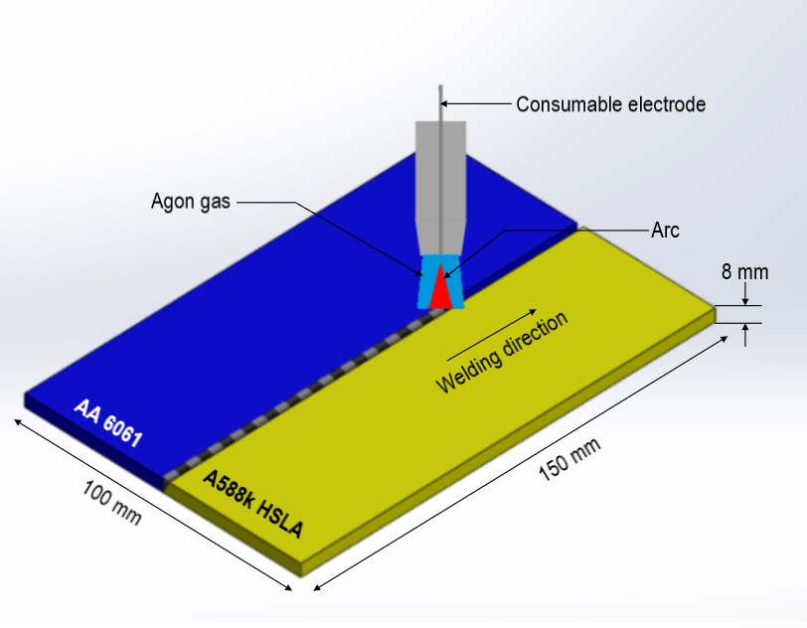
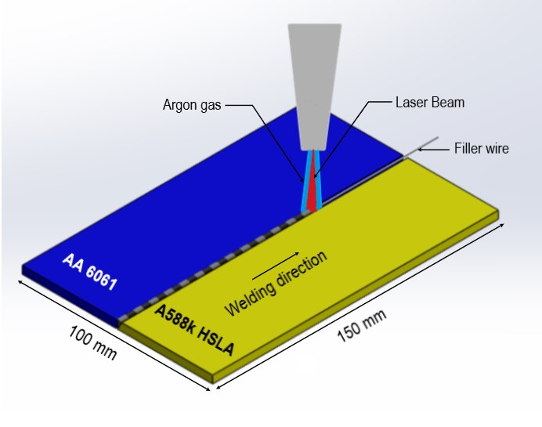
Investigation on microstructure and mechanical properties in dissimilar joint of AA6061 to HSLA steel
PROJECT PHASE 2
Argon gas
4
Figure 1 : Schematic representation of MIG welding of aluminum and steel
Figure 2 : Schematic representation of LASER welding of aluminum and steel
PAGE
Department of Mechanical Engineering
14/02/2023
15M820 | BE SW SEM 10 | 20
17-Nov-20
15M216
BE:

Slide 21
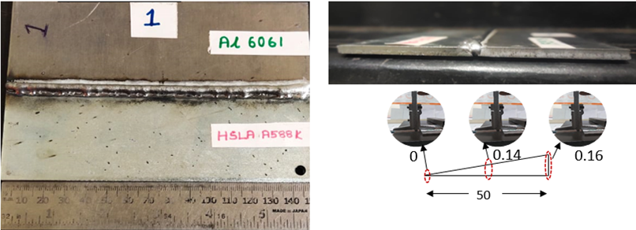
Investigation on microstructure and mechanical properties in dissimilar joint of AA6061 to HSLA steel
PROJECT PHASE 2
Figure 3 : Sample 1 MIG welding of AA6061 and A588k HSLA steel using parameters
Current (A) | Voltage (V) | Speed(mm/sec) | Wire feed (m/min) | Gas flow rate (lpm)
85 | 16.5 | 6 | 3.9 | 15
PAGE
Department of Mechanical Engineering
14/02/2023
15M820 | BE SW SEM 10 | 21
17-Nov-20
15M216
BE:

Slide 22
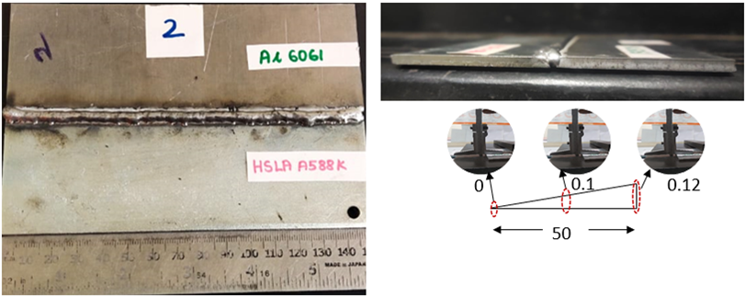
Investigation on microstructure and mechanical properties in dissimilar joint of AA6061 to HSLA steel
PROJECT PHASE 2
Figure 4 : Sample 2 MIG welding of AA6061 and A588k HSLA steel using parameters
Current (A) | Voltage (V) | Speed(mm/sec) | Wire feed (m/min) | Gas flow rate (lpm)
90 | 16.6 | 8 | 4.1 | 15
PAGE
Department of Mechanical Engineering
14/02/2023
15M820 | BE SW SEM 10 | 22
17-Nov-20
15M216
BE:

Slide 23
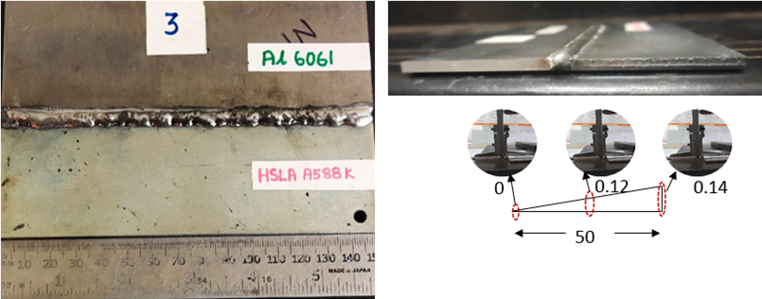
Investigation on microstructure and mechanical properties in dissimilar joint of AA6061 to HSLA steel
PROJECT PHASE 2
Figure 5 : Sample 3 MIG welding of AA6061 and A588k HSLA steel using below parameters
Current (A) | Voltage (V) | Speed(mm/sec) | Wire feed (m/min) | Gas flow rate (lpm)
100 | 16.9 | 10 | 4.5 | 15
PAGE
Department of Mechanical Engineering
14/02/2023
15M820 | BE SW SEM 10 | 23
17-Nov-20
15M216
BE:

Slide 24
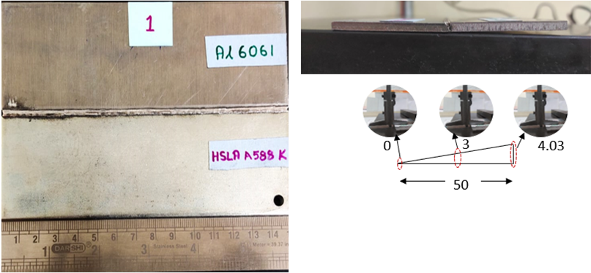
Investigation on microstructure and mechanical properties in dissimilar joint of AA6061 to HSLA steel
PROJECT PHASE 2
Figure 6 : Sample 1 Laser welding of AA6061 and A588k HSLA steel using below parameters
Power (W) | Frequency (HZ) | Pulse duration (millisecond) | Gas flow rate (lpm)
40-80 | 8-10 | 3 | 20
PAGE
Department of Mechanical Engineering
14/02/2023
15M820 | BE SW SEM 10 | 24
17-Nov-20
15M216
BE:

Slide 25
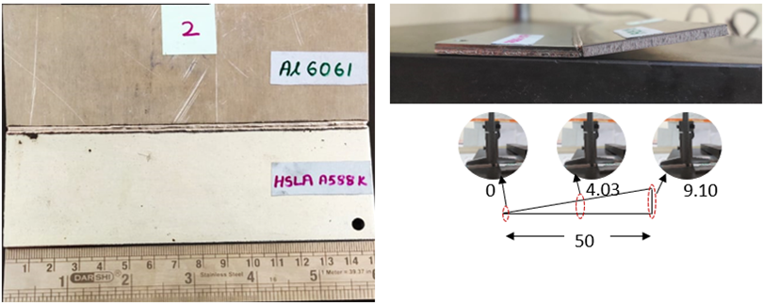
Investigation on microstructure and mechanical properties in dissimilar joint of AA6061 to HSLA steel
PROJECT PHASE 2
Figure 7 : Sample 2 Laser welding of AA6061 and A588k HSLA steel using below parameters
Power (W) | Frequency (HZ) | Pulse duration(millisecond) | Gas flow rate (lpm)
80-120 | 10-12 | 4 | 20
PAGE
Department of Mechanical Engineering
14/02/2023
15M820 | BE SW SEM 10 | 25
17-Nov-20
15M216
BE:

Slide 26
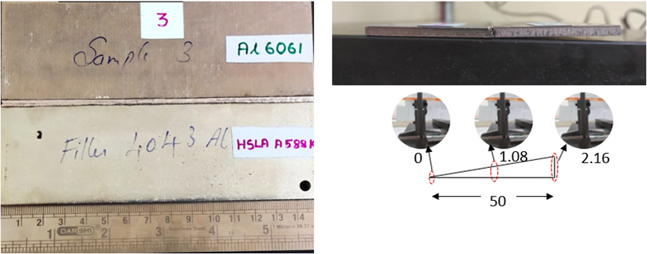
Investigation on microstructure and mechanical properties in dissimilar joint of AA6061 to HSLA steel
PROJECT PHASE 2
Figure 8 : Sample 3 Laser welding of AA6061 and A588k HSLA steel using below parameters
Power (W) | Frequency (HZ) | Pulse duration(millisecond) | Gas flow rate (lpm)
120-180 | 12 | 5 | 20
PAGE
Department of Mechanical Engineering
14/02/2023
15M820 | BE SW SEM 10 | 26
17-Nov-20
15M216
BE:

Slide 27
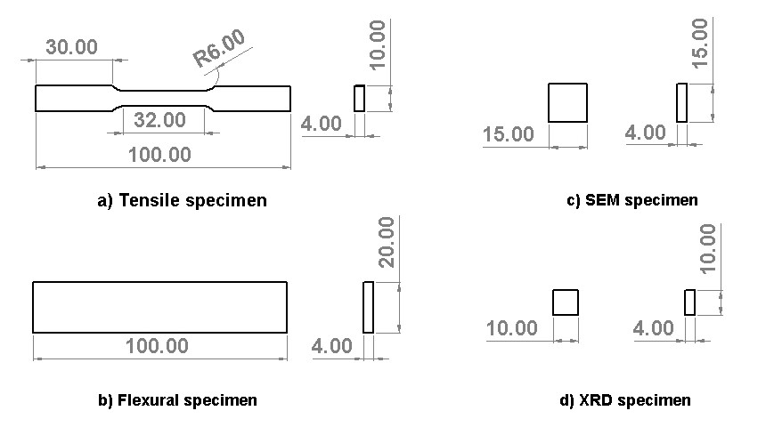
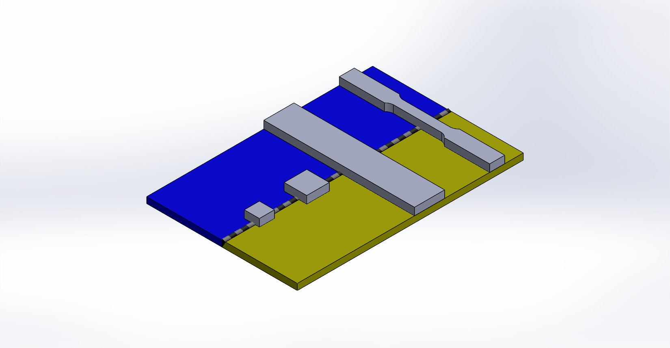
Investigation on microstructure and mechanical properties in dissimilar joint of AA6061 to HSLA steel
PROJECT PHASE 2
(a)
(c)
(b)
(d)
Figure 9 : Schematic representation of (a) tensile ASTM : E8M-13a (b) flexural ASTM E190-03, (c) SEM, (d) XRD test specimens
PAGE
Department of Mechanical Engineering
14/02/2023
15M820 | BE SW SEM 10 | 27
17-Nov-20
15M216
BE:

Slide 28
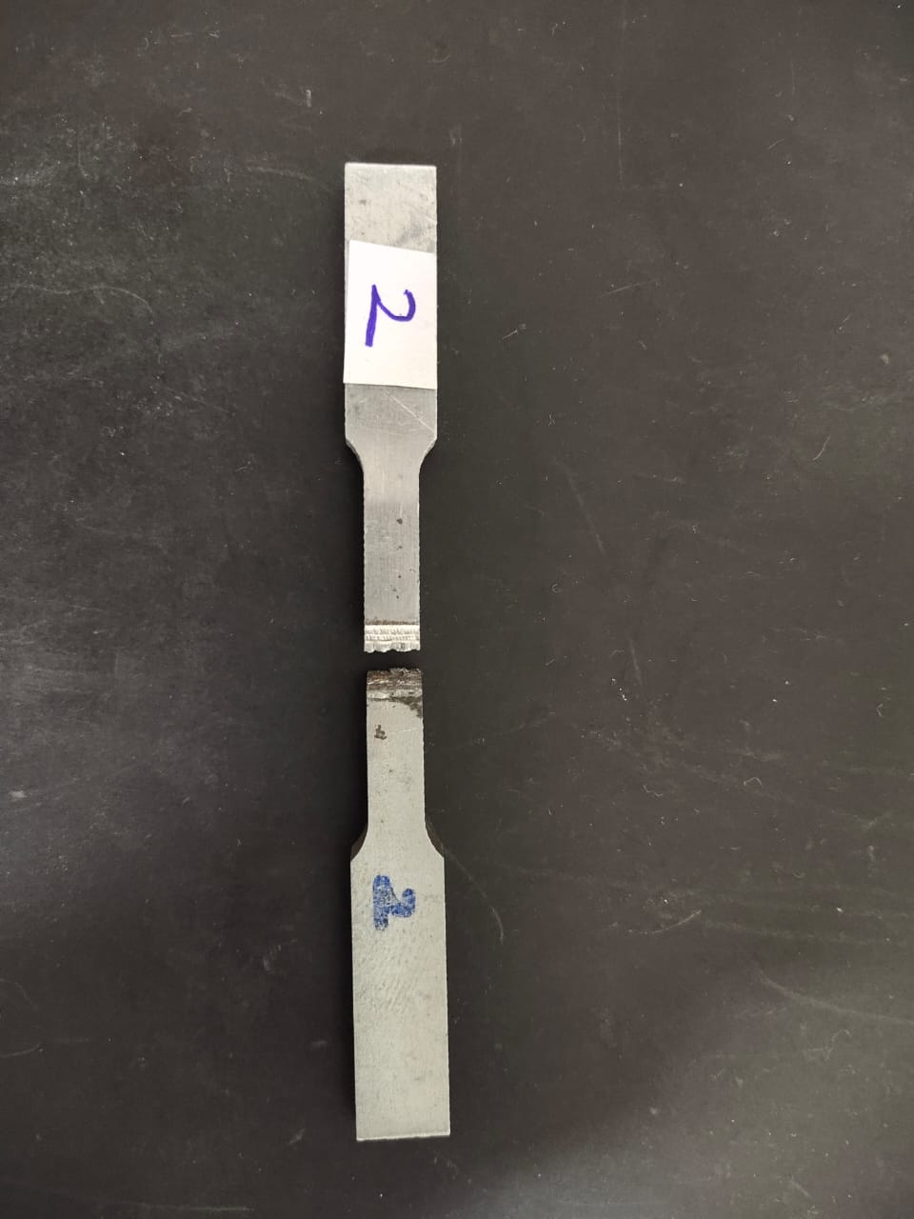
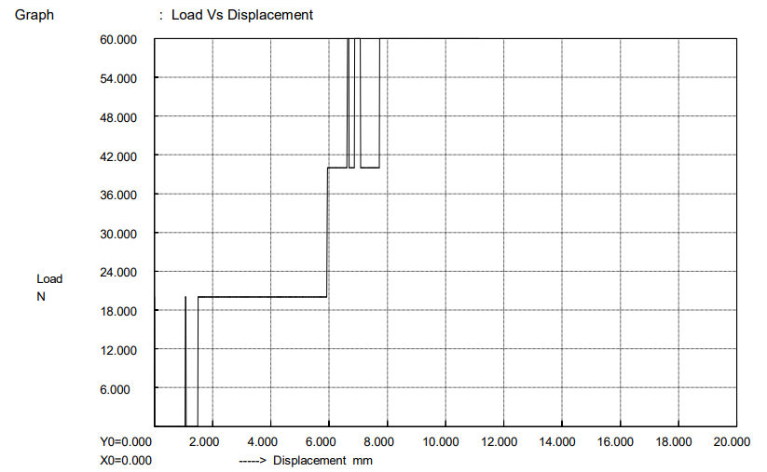
Investigation on microstructure and mechanical properties in dissimilar joint of AA 6061 to HSLA steel
PROJECT PHASE 2
Tensile test results
Figure 10 : Tensile failure of laser welding sample-2
Laser Sample - 2
Ultimate strength | 2.566 MPa
Elongation | 23.300 %
Max displacement | 11.150 mm
PAGE
Department of Mechanical Engineering
14/03/2023
15M820 | BE SW SEM 10 | 28
17-Nov-20
15M216
BE:

Slide 29
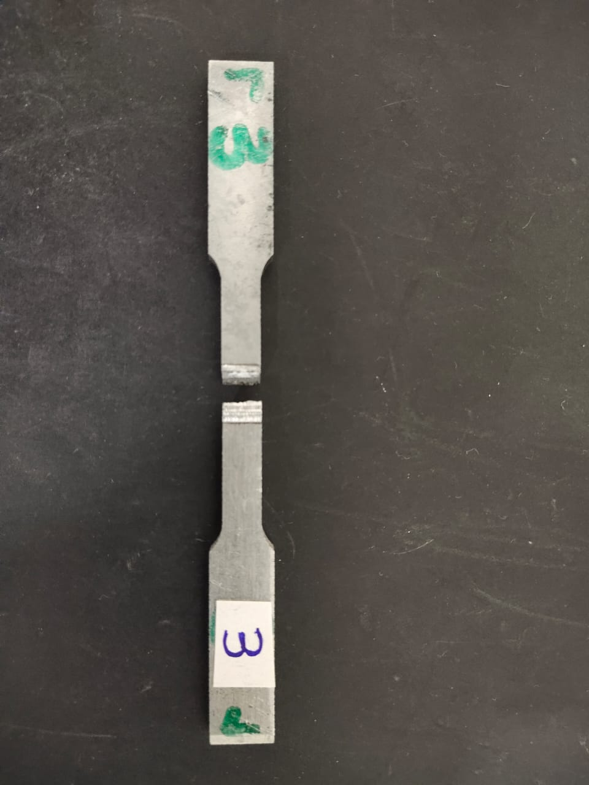
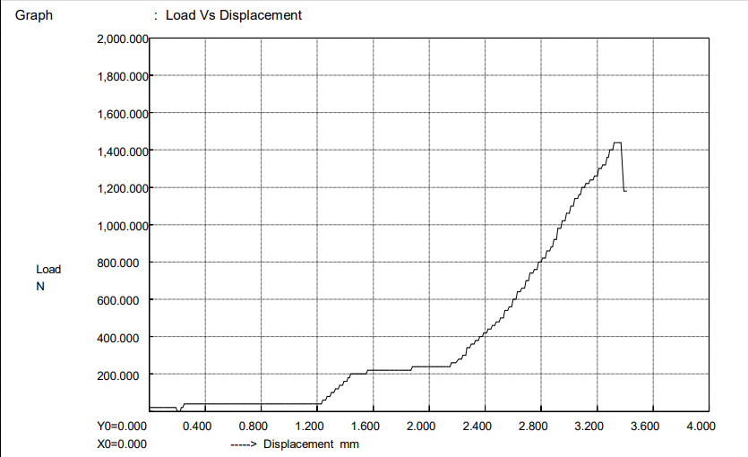
Investigation on microstructure and mechanical properties in dissimilar joint of AA 6061 to HSLA steel
PROJECT PHASE 2
Figure 11 : Tensile failure of laser welding sample-3
Laser Sample - 3
Ultimate strength | 61.378 MPa
Elongation | 6.840 %
Max displacement | 3.420 mm
PAGE
Department of Mechanical Engineering
14/03/2023
15M820 | BE SW SEM 10 | 29
17-Nov-20
15M216
BE:

Slide 30
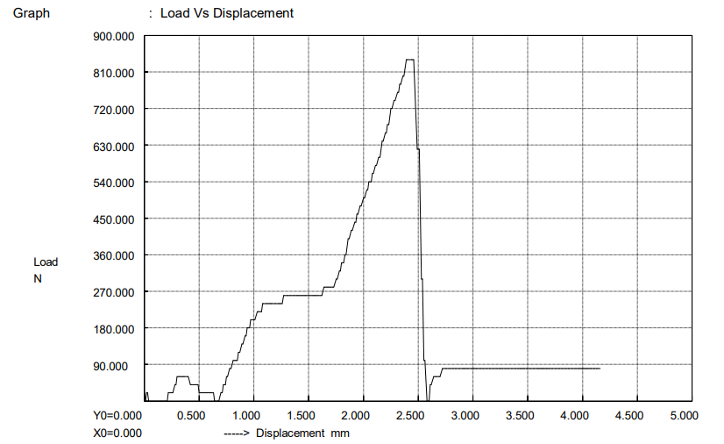
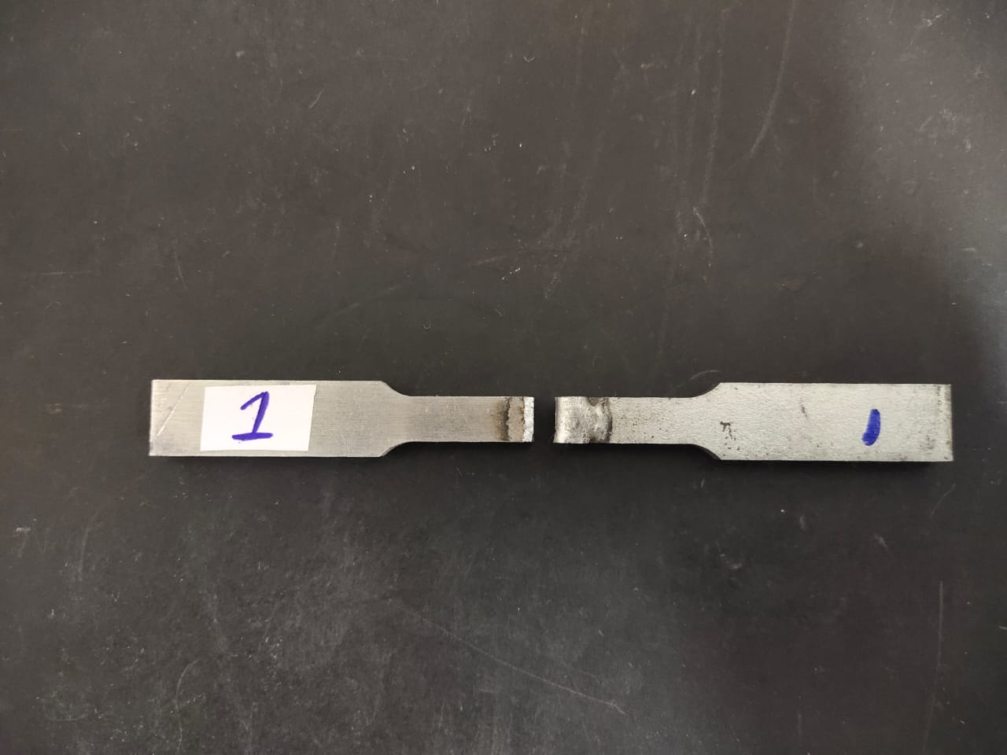
Investigation on microstructure and mechanical properties in dissimilar joint of AA 6061 to HSLA steel
PROJECT PHASE 2
Figure 12 : Tensile failure of MIG welding sample-1
MIG Sample - 1
Ultimate strength | 5.444 MPa
Elongation | 8.32 %
Max displacement | 4.160 mm
PAGE
Department of Mechanical Engineering
14/03/2023
15M820 | BE SW SEM 10 | 30
17-Nov-20
15M216
BE:

Slide 31
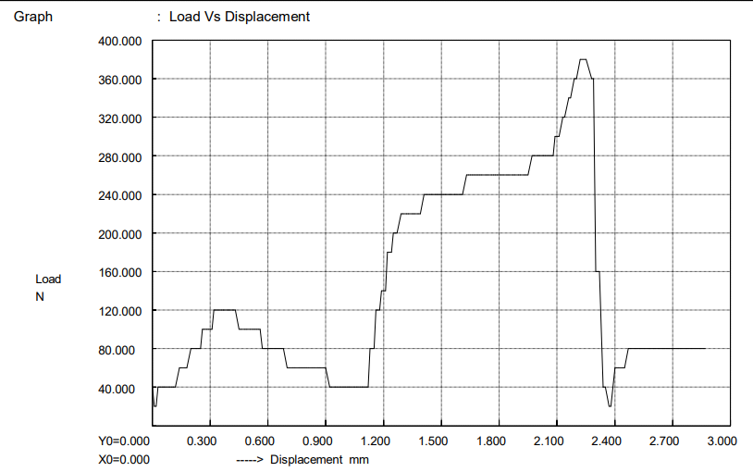
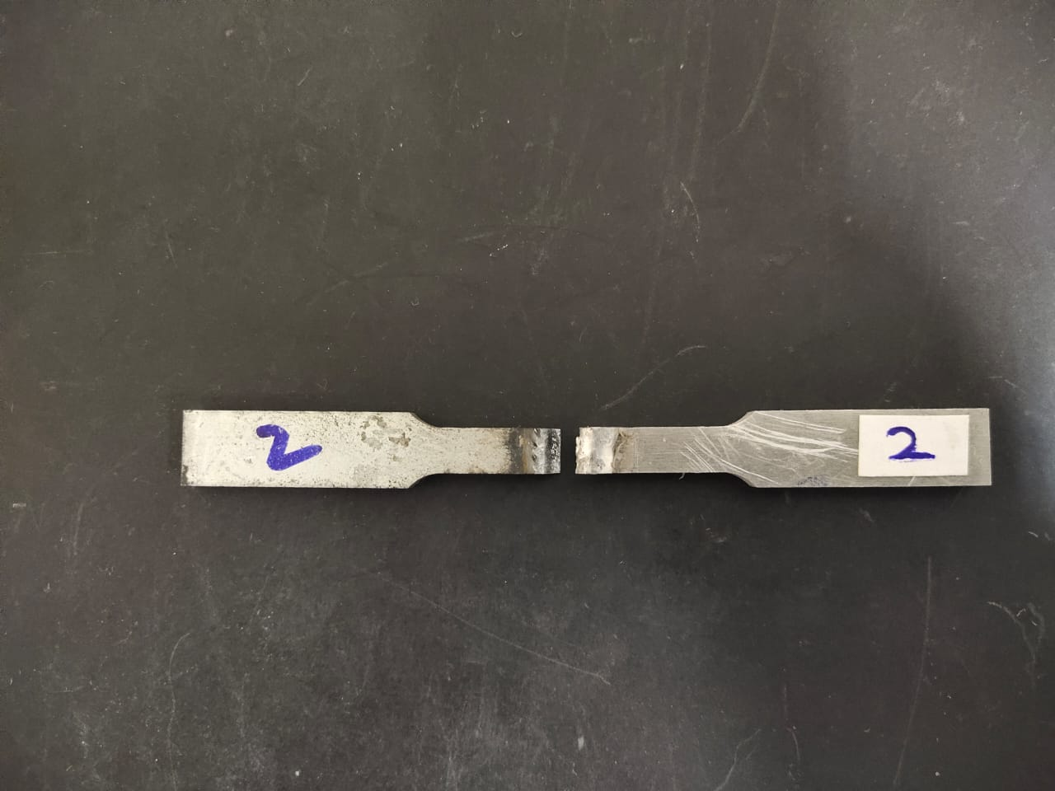
Investigation on microstructure and mechanical properties in dissimilar joint of AA 6061 to HSLA steel
PROJECT PHASE 2
Figure 13 : Tensile failure of MIG welding sample-2
MIG Sample - 2
Ultimate strength | 16.102 MPa
Elongation | 5.78 %
Max displacement | 2.890 mm
PAGE
Department of Mechanical Engineering
14/03/2023
15M820 | BE SW SEM 10 | 31
17-Nov-20
15M216
BE:

Slide 32
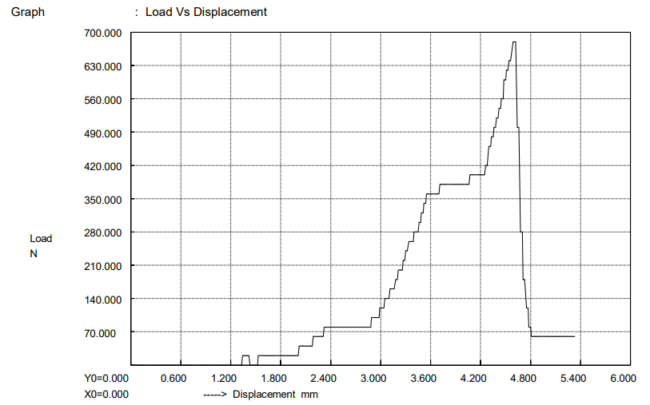
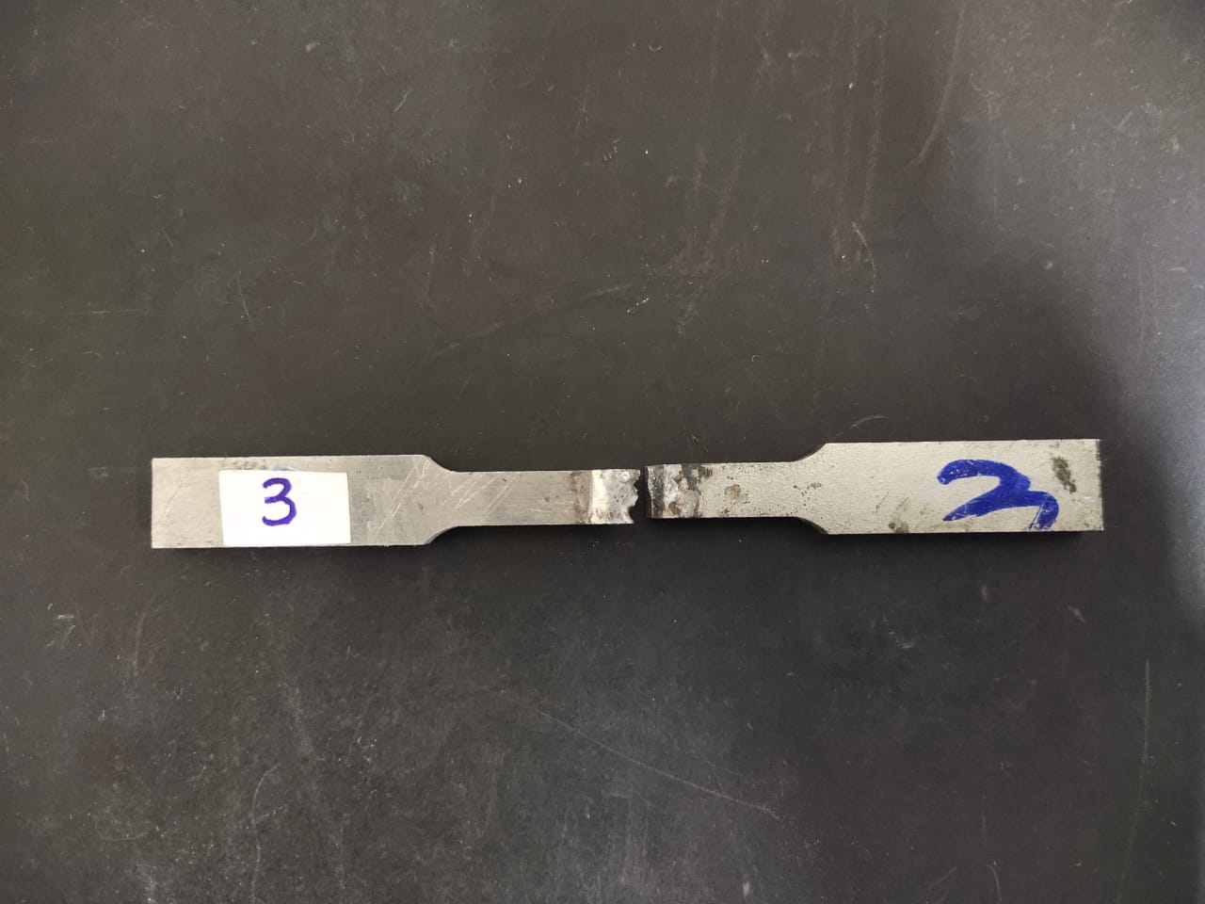
Investigation on microstructure and mechanical properties in dissimilar joint of AA 6061 to HSLA steel
PROJECT PHASE 2
Figure 14 : Tensile failure of MIG welding sample-3
MIG Sample - 3
Ultimate strength | 28.670 MPa
Elongation | 10.68 %
Max displacement | 5.340 mm
PAGE
Department of Mechanical Engineering
14/03/2023
15M820 | BE SW SEM 10 | 32
17-Nov-20
15M216
BE:

Slide 33
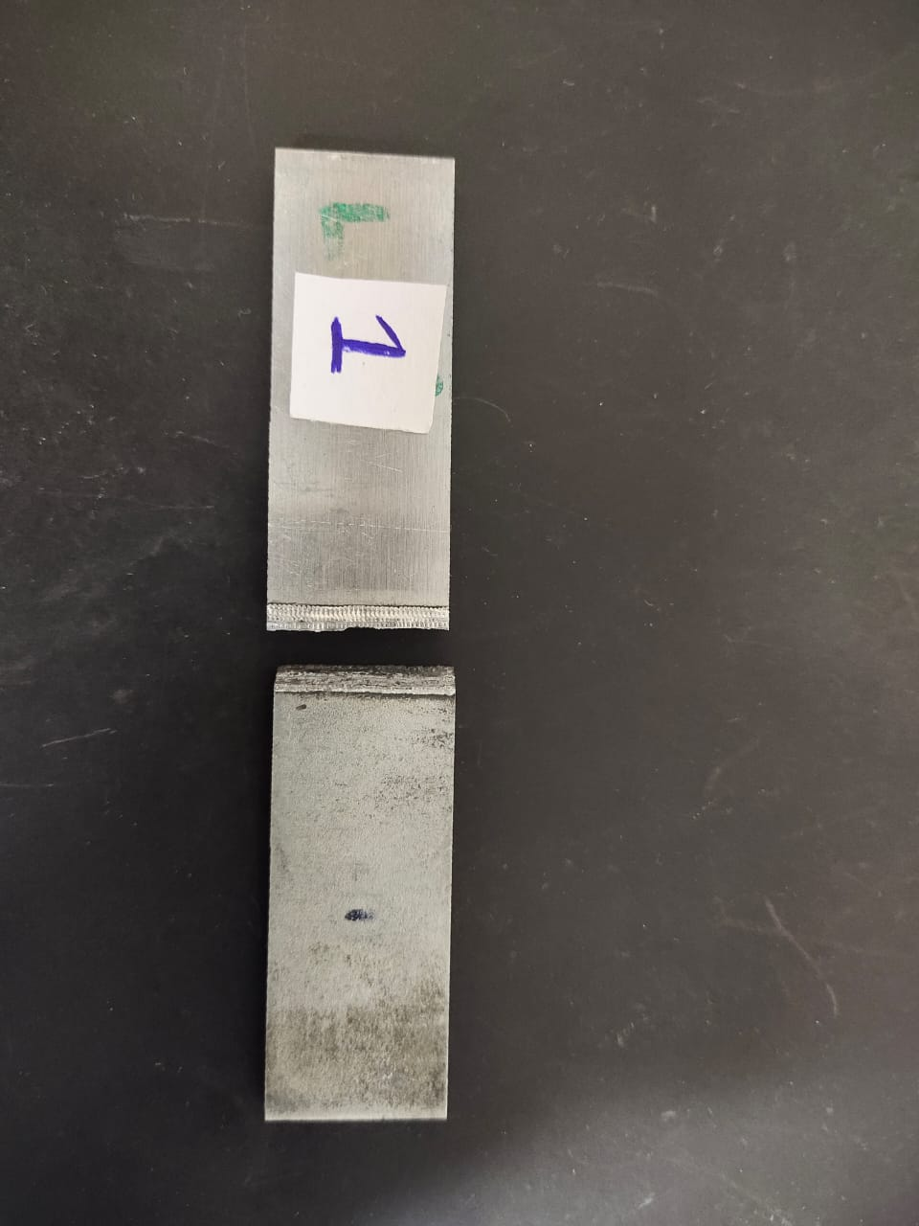
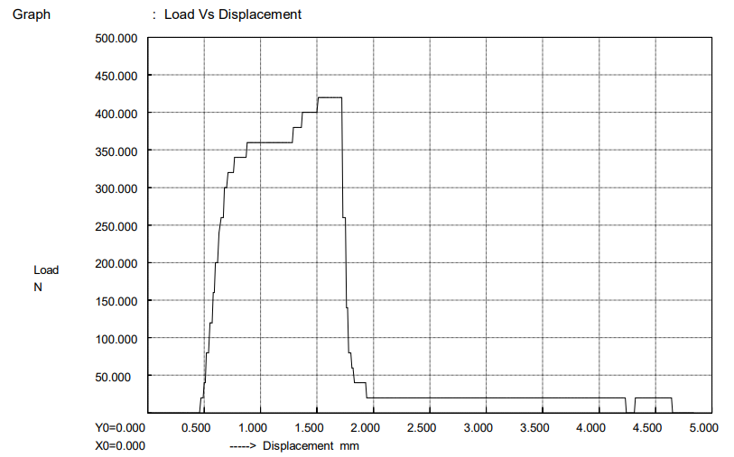
Investigation on microstructure and mechanical properties in dissimilar joint of AA 6061 to HSLA steel
PROJECT PHASE 2
Compression test results
Figure 15 : Compression failure of laser welding sample-1
Laser Sample - 1
Compression strength | 5.381 MPa
Elongation | 9.68 %
Max displacement | 4.840 mm
PAGE
Department of Mechanical Engineering
14/03/2023
15M820 | BE SW SEM 10 | 33
17-Nov-20
15M216
BE:

Slide 34
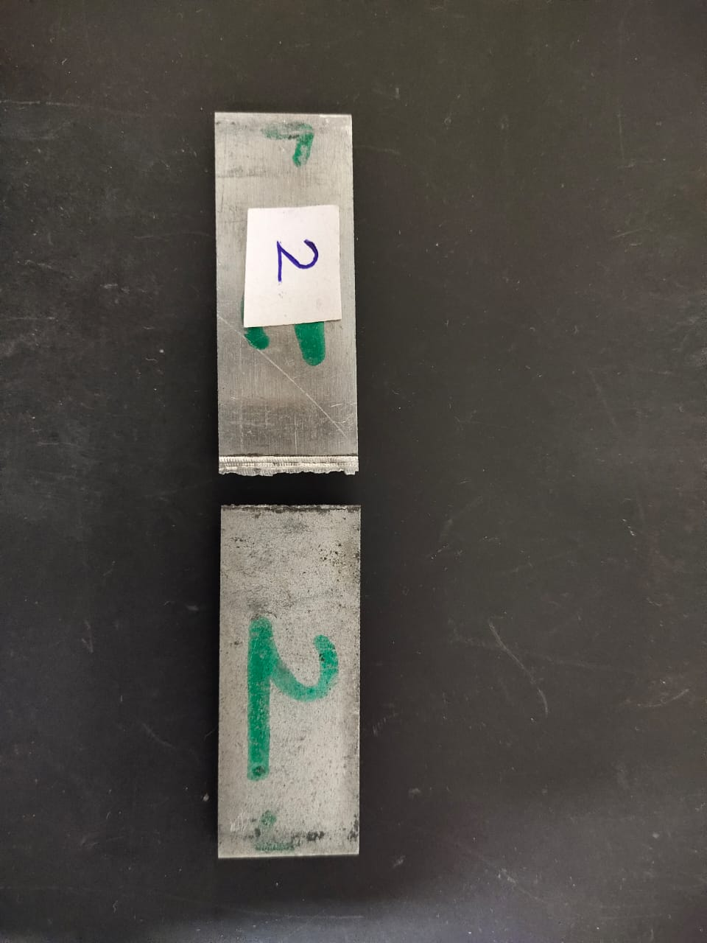
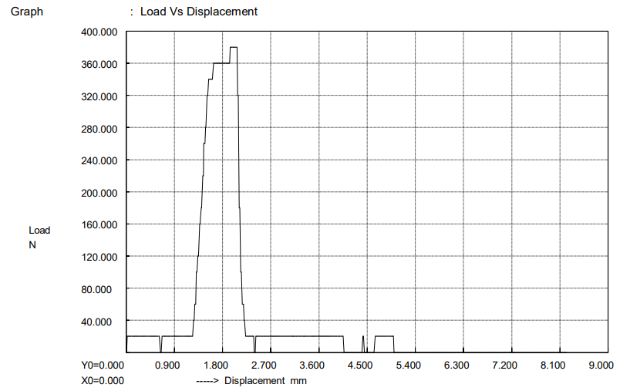
Investigation on microstructure and mechanical properties in dissimilar joint of AA 6061 to HSLA steel
PROJECT PHASE 2
Figure 16 : Compression failure of laser welding sample-2
Laser Sample - 2
Compression strength | 4.741 MPa
Elongation | 16.48 %
Max displacement | 8.240 mm
PAGE
Department of Mechanical Engineering
14/03/2023
15M820 | BE SW SEM 10 | 34
17-Nov-20
15M216
BE:

Slide 35
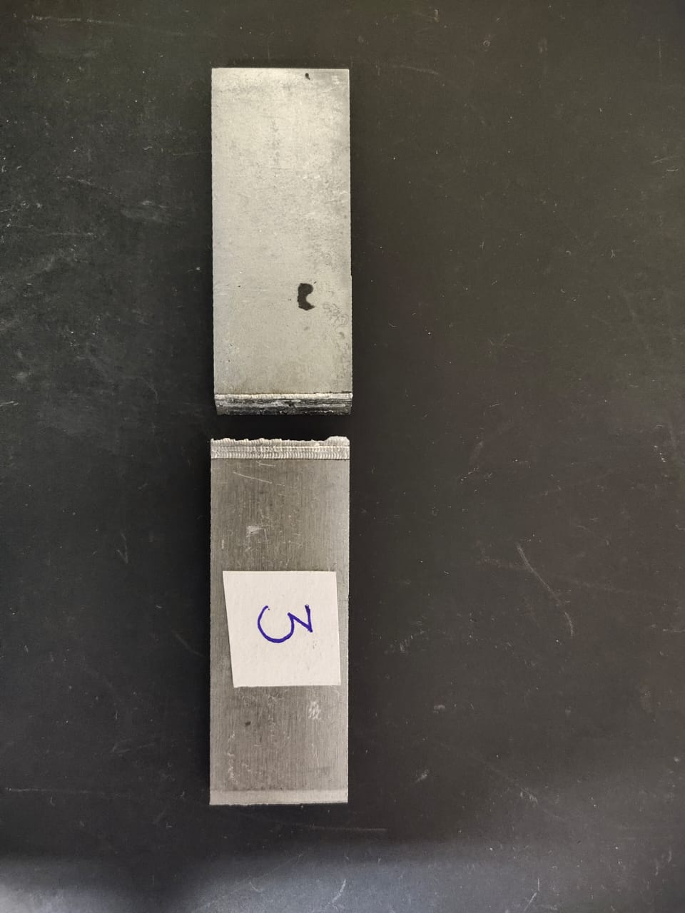
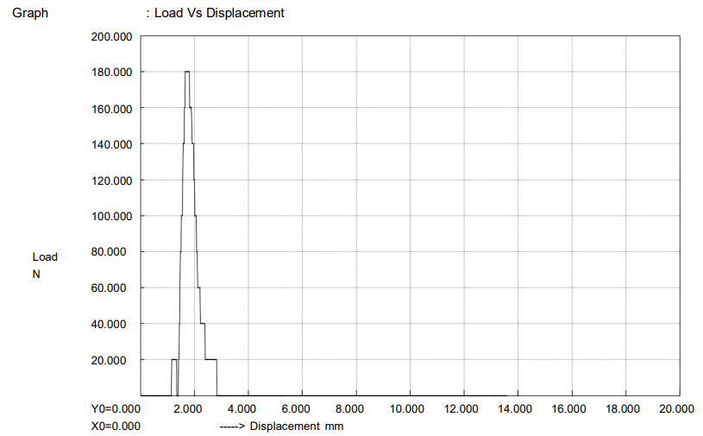
Investigation on microstructure and mechanical properties in dissimilar joint of AA 6061 to HSLA steel
PROJECT PHASE 2
Figure 17 : Compression failure of laser welding sample-3
Laser Sample - 3
Compression strength | 5.555 MPa
Elongation | 6.38 %
Max displacement | 3.190 mm
PAGE
Department of Mechanical Engineering
14/03/2023
15M820 | BE SW SEM 10 | 35
17-Nov-20
15M216
BE:

Slide 36
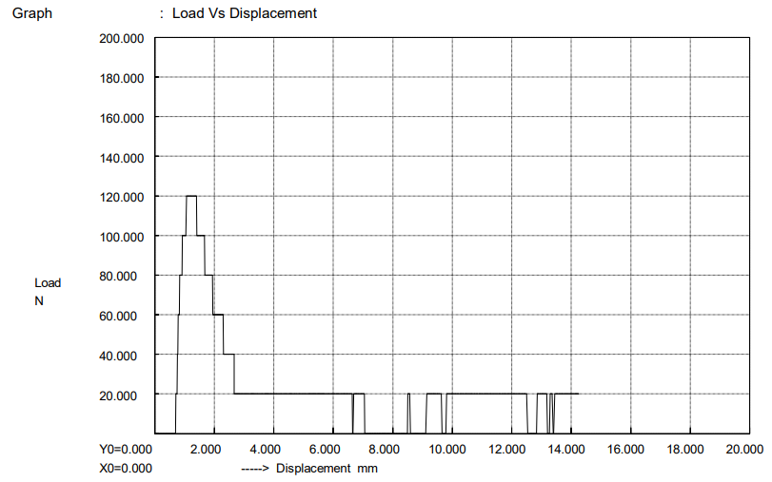
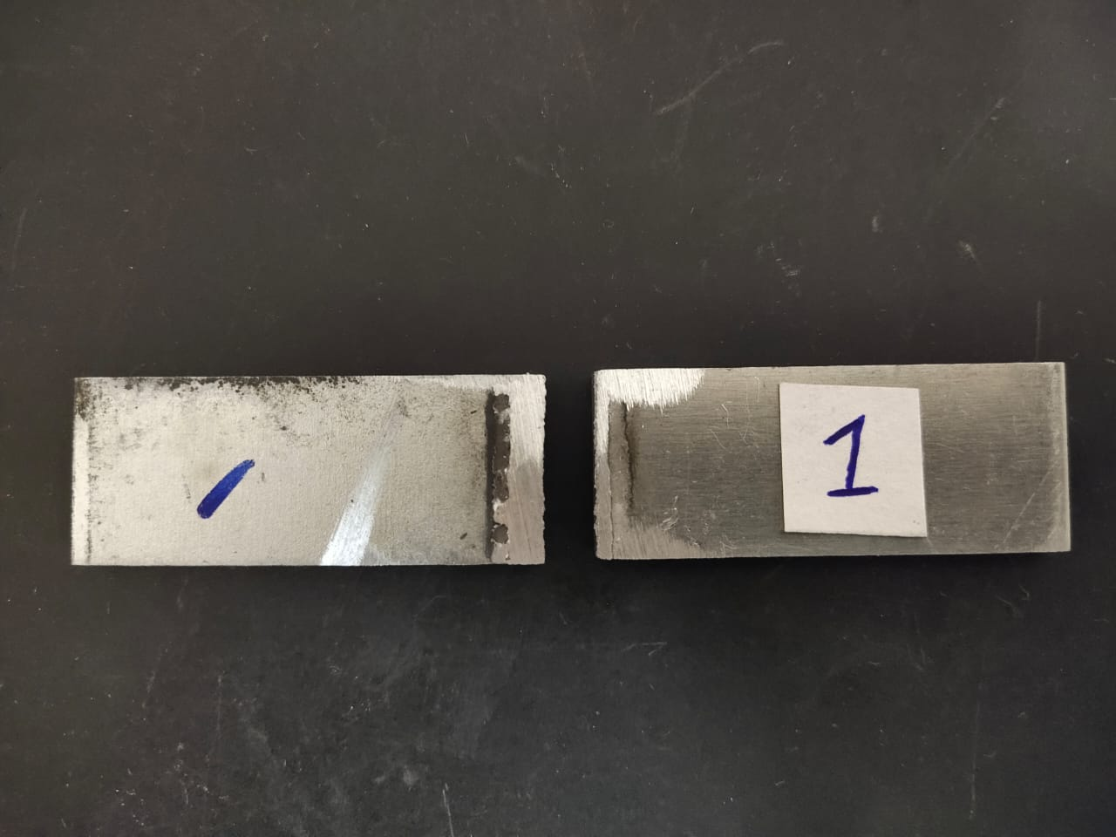
Investigation on microstructure and mechanical properties in dissimilar joint of AA 6061 to HSLA steel
PROJECT PHASE 2
Figure 18 : Compression failure of MIG welding sample-1
MIG Sample - 1
Compression strength | 1.504 MPa
Elongation | 28.5 %
Max displacement | 14.250 mm
PAGE
Department of Mechanical Engineering
14/03/2023
15M820 | BE SW SEM 10 | 36
17-Nov-20
15M216
BE:

Slide 37
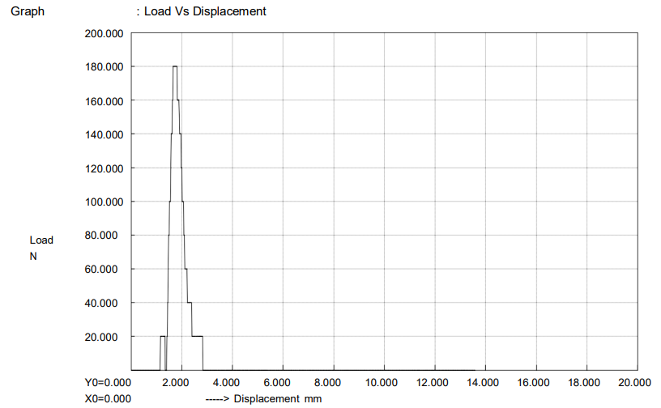
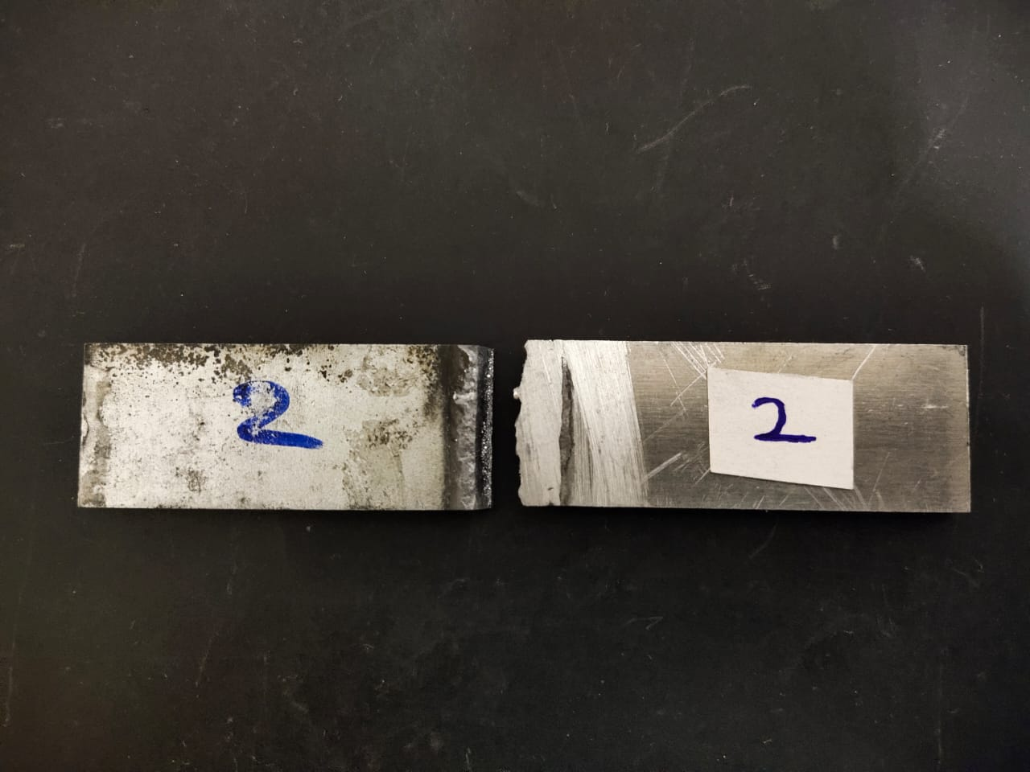
Investigation on microstructure and mechanical properties in dissimilar joint of AA 6061 to HSLA steel
PROJECT PHASE 2
Figure 19 : Compression failure of MIG welding sample-2
MIG Sample - 2
Compression strength | 2.264 MPa
Elongation | 27.2 %
Max displacement | 13.600 mm
PAGE
Department of Mechanical Engineering
14/03/2023
15M820 | BE SW SEM 10 | 37
17-Nov-20
15M216
BE:

Slide 38
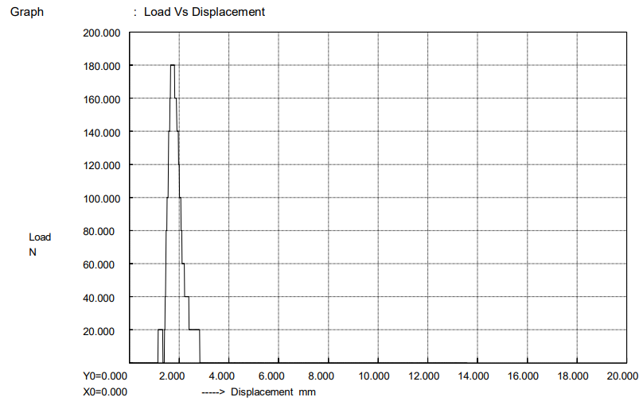
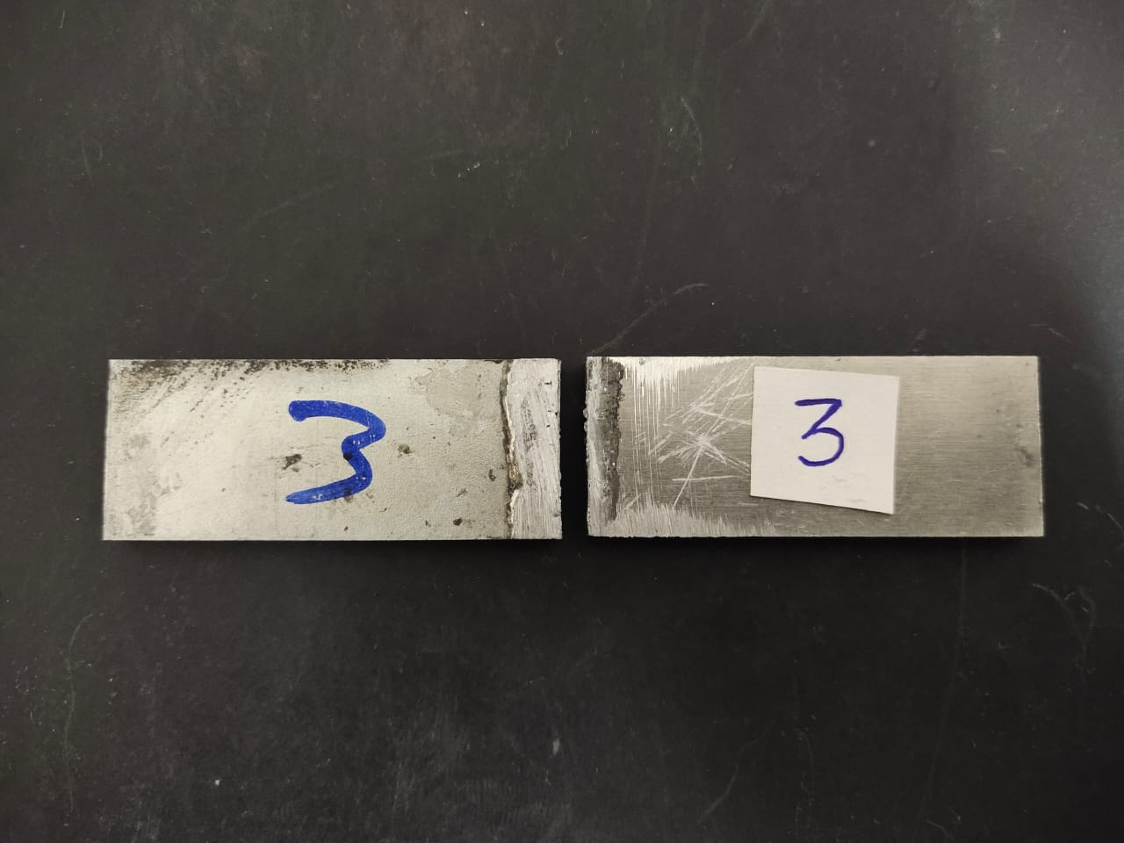
Investigation on microstructure and mechanical properties in dissimilar joint of AA 6061 to HSLA steel
PROJECT PHASE 2
Figure 20 : Compression failure of MIG welding sample-3
MIG Sample - 3
Compression strength | 2.242 MPa
Elongation | 27.2 %
Max displacement | 13.600 mm
PAGE
Department of Mechanical Engineering
14/03/2023
15M820 | BE SW SEM 10 | 38
17-Nov-20
15M216
BE:

Slide 39
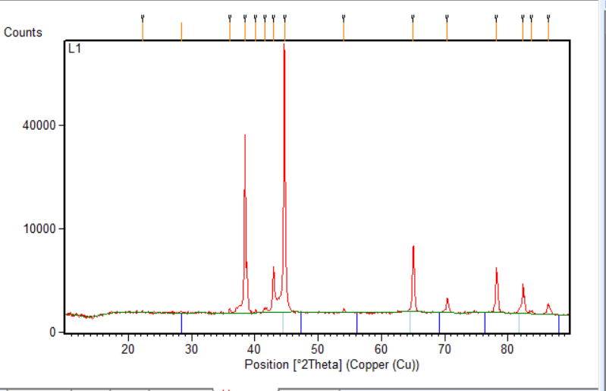
Investigation on microstructure and mechanical properties in dissimilar joint of AA6061 to HSLA steel
PROJECT PHASE 2
X-ray diffraction test results
2θ | d-spacing
22.31 | 0.31
28.40 | 0.63
36.02 | 0.26
38.44 | 0.16
40.14 | 0.16
41.64 | 0.52
42.97 | 0.21
44.68 | 0.16
54.07 | 0.21
65.01 | 0.26
70.42 | 0.21
78.16 | 0.16
82.36 | 0.16
83.63 | 0.31
86.33 | 0.26
Figure 21 : Intensity vs 2θ graph of laser welding sample-1
PAGE
Department of Mechanical Engineering
14/03/2023
15M820 | BE SW SEM 10 | 39
17-Nov-20
15M216
BE:

Slide 40
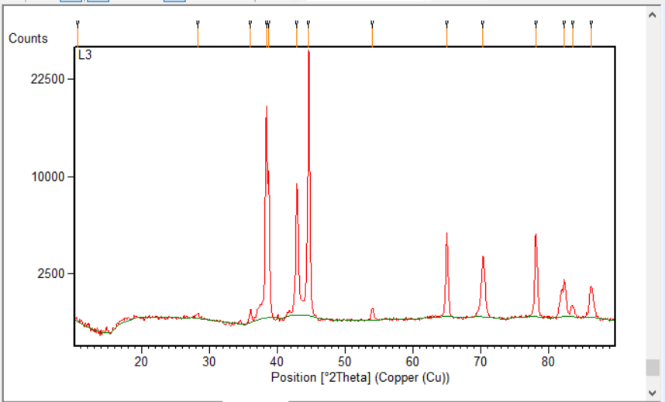
Investigation on microstructure and mechanical properties in dissimilar joint of AA6061 to HSLA steel
PROJECT PHASE 2
2θ | d-spacing
10.47 | 0.83
28.22 | 0.63
36.00 | 0.21
38.33 | 0.21
38.70 | 0.16
42.88 | 0.26
44.62 | 0.26
54.04 | 0.31
64.97 | 0.31
70.35 | 0.42
78.11 | 0.21
82.35 | 0.21
83.56 | 0.42
86.27 | 0.57
10.47 | 0.83
Figure 22 : Intensity vs 2θ graph of laser welding sample-3
PAGE
Department of Mechanical Engineering
14/03/2023
15M820 | BE SW SEM 10 | 40
17-Nov-20
15M216
BE:

Slide 41
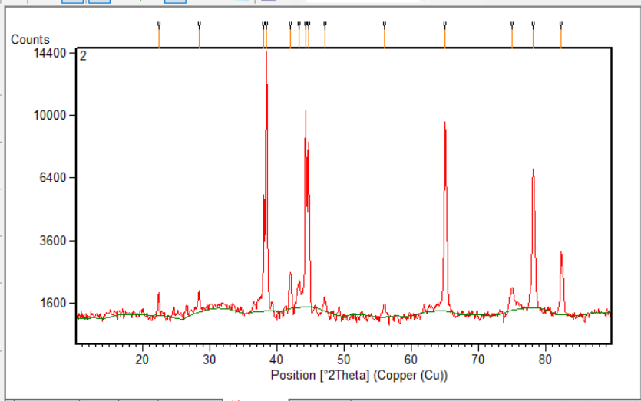
Investigation on microstructure and mechanical properties in dissimilar joint of AA6061 to HSLA steel
PROJECT PHASE 2
2θ | d-spacing
22.35 | 0.16
28.33 | 0.21
38.02 | 0.10
38.41 | 0.16
41.99 | 0.31
43.30 | 0.16
44.25 | 0.16
44.67 | 0.16
47.11 | 0.31
55.97 | 0.63
65.03 | 0.31
75.02 | 0.31
78.15 | 0.31
82.37 | 0.21
22.35 | 0.16
Figure 23 : Intensity vs 2θ graph of MIG welding sample-2
PAGE
Department of Mechanical Engineering
14/03/2023
15M820 | BE SW SEM 10 | 41
17-Nov-20
15M216
BE:

Slide 42
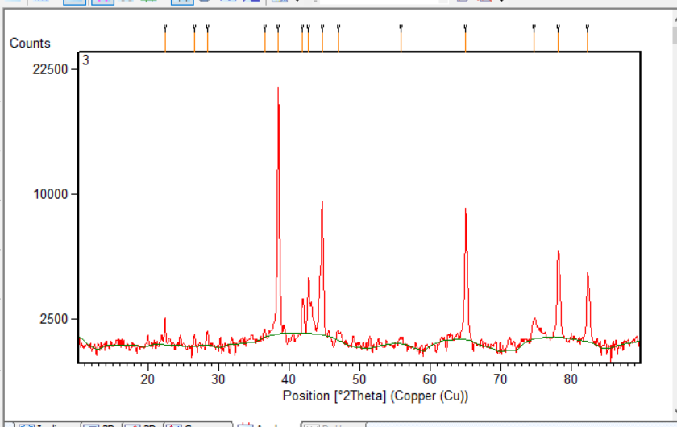
Investigation on microstructure and mechanical properties in dissimilar joint of AA6061 to HSLA steel
PROJECT PHASE 2
2θ | d-spacing
22.32 | 0.21
26.52 | 0.31
28.33 | 0.26
36.50 | 0.31
38.42 | 0.21
41.86 | 0.31
42.72 | 0.21
44.67 | 0.21
47.04 | 0.63
55.89 | 0.63
65.04 | 0.31
74.70 | 0.52
78.17 | 0.26
82.37 | 0.21
22.32 | 0.21
Figure 24 : Intensity vs 2θ graph of MIG welding sample-3
PAGE
Department of Mechanical Engineering
14/03/2023
15M820 | BE SW SEM 10 | 42
17-Nov-20
15M216
BE:

Slide 43
Investigation on microstructure and mechanical properties in dissimilar joint of AA6061 to HSLA steel
PROJECT PHASE 2
References
Rao P N, “Manufacturing Technology” Tata McGraw Hill Publishing Co. Ltd., Volume 1, New Delhi,2010.
M.J. Torkamany, S. Tahamtan, J. Sabbaghzadeh, Dissimilar welding of carbon steel to 5754 aluminum alloy by Nd: YAG pulsed laser, Mater. Des. 31 (2010) 458–465.
J.L. Song, S.B. Lin, C.L. Yang, C.L. Fan, Effects of Si additions on intermetallic compound layer of aluminum-steel TIG welding–brazing joint, J. Alloys Compd. 488 (2009) 217–222.
J.L. Song, S.B. Lin, C.L. Yang, C.L. Fan, Brazability of dissimilar metals tungsten inert gas butt welding–brazing between aluminum alloy and stainless steel with Al–Cu filler metal, J. Alloys Compd. 488 (2009) 217–222.
C. Dharmendraa, K.P. Raoa, J. Wildenb, S. Reich, Study on laser welding–brazing of zinc coated steel to aluminum alloy with a zinc based filler, A 528 (2011) 1497–1503.
Junhao Sun, Qi Yan, Wei Gao, Jian Huang, Investigation of laser welding on butt joints of Al/steel dissimilar materials, 83 (2015) 120–128.
PAGE
Department of Mechanical Engineering
14/03/2023
15M820 | BE SW SEM 10 | 43
17-Nov-20
15M216
BE:

Slide 44
Investigation on microstructure and mechanical properties in dissimilar joint of AA6061 to HSLA steel
PROJECT PHASE 2
References
A.S. Elmesalamy, J.A. Francis, L. Li, A Comparison of Residual Stresses in Multi Pass Narrow Gap Laser Welds and Gas-Tungsten Arc Welds in AISI 316L Stainless Steel, 10.1016/j.ijpvp.2013.11.002.
Seiji Katayama, Sung-Min Joo, Masami Mizutani and Han-Sur Bang, Laser Weldability of Aluminum Alloy and Steel, Vol 502 (2005) pp 481- 486.
M Kutsuna , N Yamagami , M J Rathod & H Y Azar Ammar, Laser roll welding for joining of low-carbon steels to aluminium alloys.
PAGE
Department of Mechanical Engineering
14/03/2023
15M820 | BE SW SEM 10 | 44
17-Nov-20
15M216
BE:

Slide 45
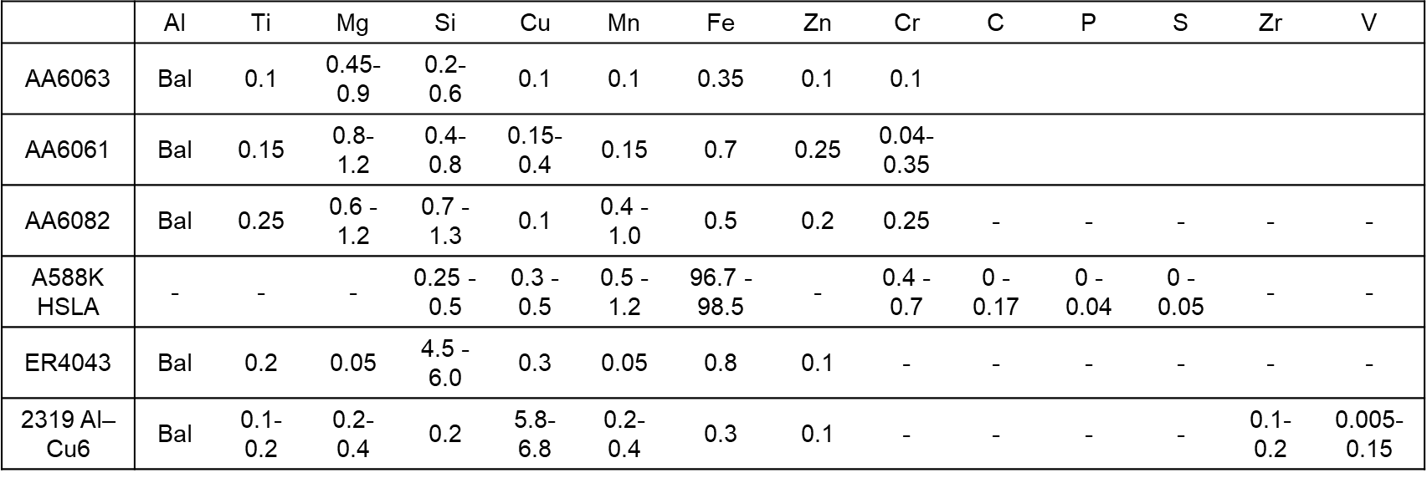
Investigation on microstructure and mechanical properties in dissimilar joint of AA6061 to HSLA steel
PROJECT PHASE 2
COMPOSITION TABLE
Table 1 : Showing the composition of aluminium alloy and steel alloy
* From journal paper “Investigation of laser welding on butt joints of Al/steel dissimilar materials”
^{y}
PAGE
Department of Mechanical Engineering
14/02/2023
15M820 | BE SW SEM 10 | 30
17-Nov-20
15M216
BE:

Slide 46
Investigation on microstructure and mechanical properties in dissimilar joint of AA6061 to HSLA steel
PROJECT PHASE 2
PAGE
Department of Mechanical Engineering
14/02/2023
15M820 | BE SW SEM 10 | 24
17-Nov-20
15M216
BE:

Slide 47
Investigation on microstructure and mechanical properties in dissimilar joint of AA6061 to HSLA steel
PROJECT PHASE 2
Applications
The motive for efficient joining of Al alloy and steel mainly arises from the
need for weight reduction in view of enhancing energy efficiency and reducing
the adverse impact on environment in automotive and marine sectors. It also
finds applications in process industries, space crafts, locomotives and
cryogenics
PAGE
Department of Mechanical Engineering
14/02/2023
15M820 | BE SW SEM 10 | 25
17-Nov-20
15M216
BE:

